Slide 1
THE AGGRESSIVE/ VIOLENT PATIENT
OPIO JOEL
G COHES

Slide 2
Outline
Introduction
Causes of aggression/Violence
Physical restraint
Mechanical restraint
Chemical restraint
Seclusion

Slide 3
Introduction
Majority of psychiatric patients are not aggressive and are not violent
However in some situations, one encounters such a patient
It is important to be able to know how to handle such a patient
May also be encountered on other wards

Slide 4
Psychiatric causes of aggression/Violence
Substance intoxication
Substance withdrawal
Chronic mental illness eg (schizophrenia)
Acute organic states eg delirium
Acutely ill (mania, paranoia)
Exhibiting borderline, antisocial, paranoid personality disorders

Slide 5
Physical causes of aggression/ violence
Postictal confusion
Temporal Lobe Epilepsy
Liver failure
Meningitis
Hypogylcaemia
Delirium from other causes

Slide 6
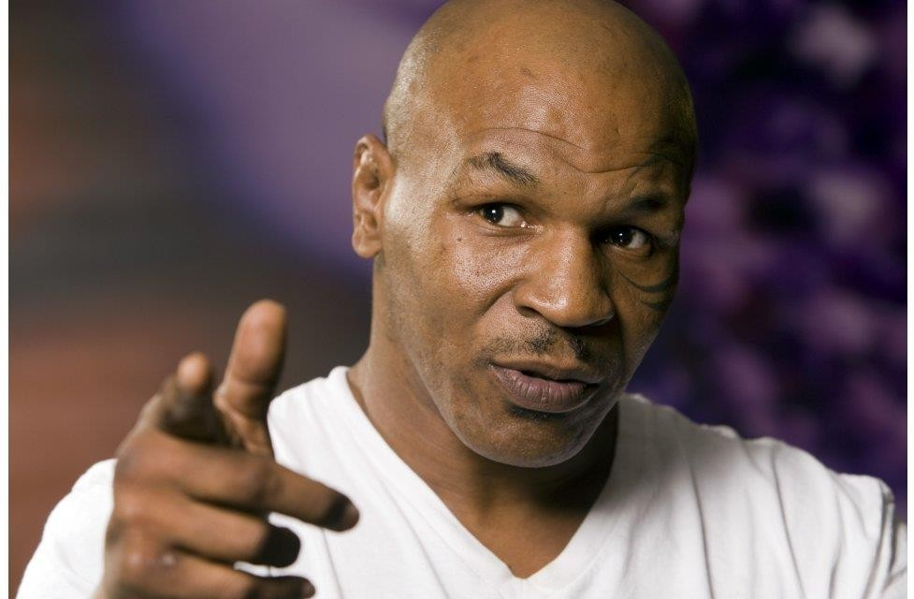
Can we predict violence?

Slide 7
Warning signs
Clenching fists/jaws
Pacing or showing impatient behaviour
Sitting at edge of chair
Slamming door, banging furniture or walls
Hitting the palm of the hand with fist
Very jump and easy to startle
Loud, threatening
Suddenly calm

Slide 8
How to avoid aggression/violence
Professional conduct
Warm therapeutic relationship Physical structure of units
Design of rooms with multiple exits
Doors with observation panel
Presence of other staff
Camera
Remove potential weapons

Slide 9
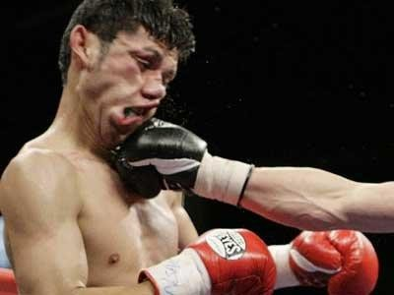

VERBAL DE-ESCALATION
CHEMICAL RESTRAINT (TRANQUILISATION)
PHYSICAL RESTRAINT

Slide 10
Verbal De-escalation
Approach patient calmly and respectfuly
From patients line of sight
Hands in plain view of patient
Introduce self
Speak softly and calmly
Mind your own body language
Ask patient cause of distress
Come to an understanding

Slide 11
Verbal de-escalation
You may..
Use humor
Offer drink/food
Offer a seat
Offer a quiet place to rest eg bed
Compliment cooperativeness

Slide 12
Physical restraint
Best done by a 5 man( or woman) team
1 person for each limb
1 person as team leader and in charge of airway
To avoid movement, stabilize limb at joints. Don’t
just hold
May hold against floor or the wall
Use the minimum necessary force
Remember medical ethics: First do no harm

Slide 13
Mechanical restraint
Use of special beds with straps
Use of straight jacket
Ropes are not encouraged
Seclusion rooms
Should always be monitored, used for minimum time

Slide 14
Chemical restraint
Also called Rapid tranquilisation
Favoured because it last long, and has less risks to the patient
Depends of the cause of the aggression or violence
Sometimes it is not necessary

Slide 15
RAPID TRANQULISATION
ANTIPSYCHOTIC MEDICATION
SEDATIVE
MEDICATION

Slide 16
Antipsychotic medication
Best given im or orally
Different settings have different protocol
In Uganda; Chlorpromazine, Haloperidol, Risperidone, Quetiapine, Olanzapine

Slide 17
Sedating medications
Benzodiazepines best option
These maybe given orally, im or iv
IV route is safe and faster
In Uganda; Diazepam, Lorazepam, Midazolam, Clonazepam

Slide 18
Case 1
Patricia is a 32 year old banker who came in with her son. She was called to pick her 8 year old son from school and take him for medical attention since he had a seizure during class.
She came to the hospital at 10am but because Mondays are busy days in the out patient clinic, it is now 3pm but her son has not yet been seen.

Slide 19
You are in one of the consultation rooms tending to patients but you begin to hear a commotion outside, in the waiting area.
A nurse tells you that one of the patients is outside complaining, shouting and threating other patients who she says are skipping the line. She is also saying that nurses are taking bribes from some to get medical attention sooner.

Slide 20
The noise and commotion outside is getting louder and louder. Other patients are joining in and it is now hard for you to continue work as the noise is too much to hear what your patients in the consultation room are saying.
How would you manage this situation?

Slide 21
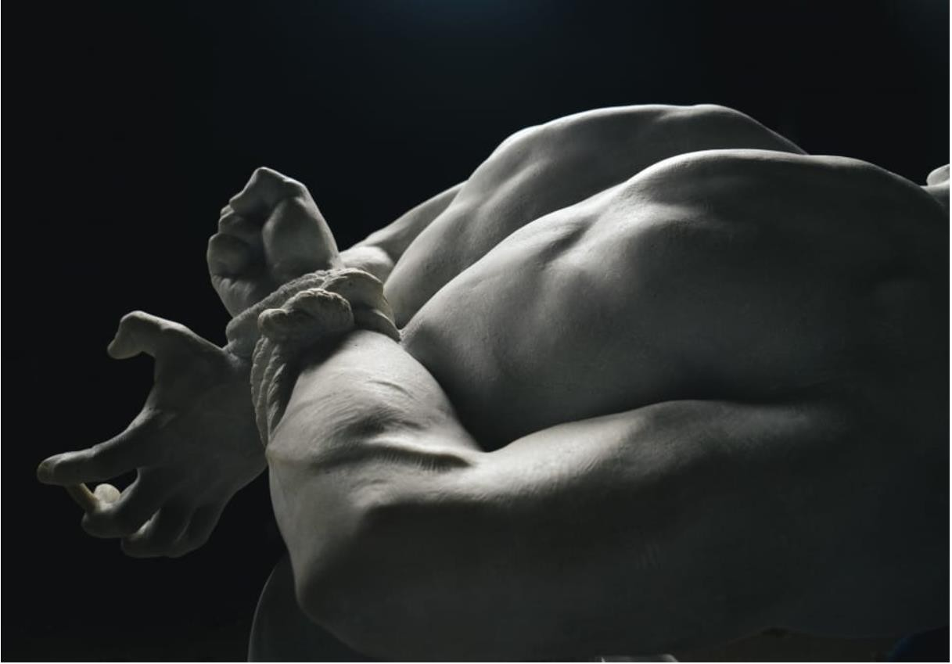
Case 2

Slide 22
Collins is a 25 year old university student. He is
the president of the sport’s club. He is reported to have been well until a few hours ago when his classmates noticed that he was taking the friendly match between his class and other class from the agriculture faculty a little too serious.
He woke up early in the morning and went to the field to do drills in preparation for the match. He tried to get the other teammates to join him but was unsuccessful as they insisted that they could not miss lectures.

Slide 23
When the match started in the evening, he was soon kicked off the game with a red card for being too rough on others.
Unfortunately, his team lost the match and this is when the situation took a turn for the worse. Collins grabbed a stick and started beating the agriculture students. Eventually, he also started beating medical students accusing them of betraying their own class.

Slide 24
His classmates got a hold of him and have tied him with ropes.
When they bring him to you, he is shouting, screaming, threatening violence and attempting to break out of the restraints.
He is a very muscular your man and weights 90kgs

Slide 25
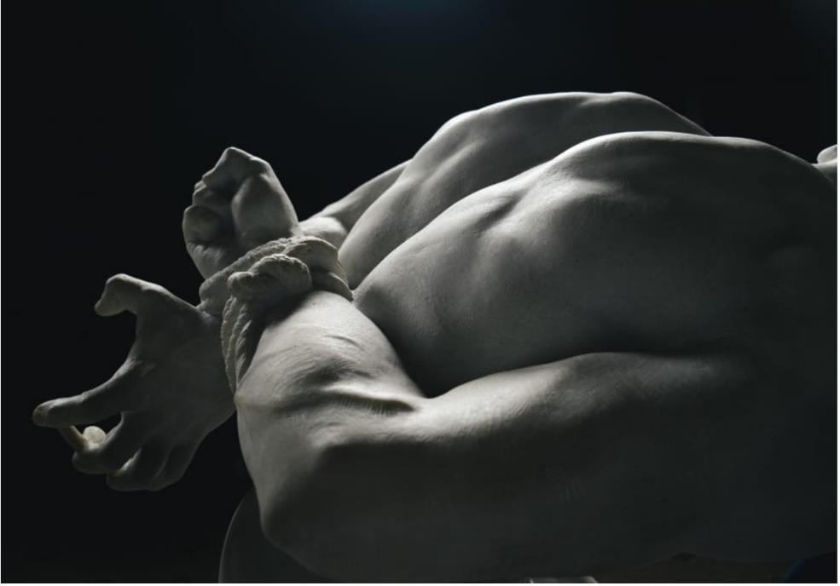
1.How would you manage?
2.Would you use medication? Give details of the drugs and dosage

Slide 26
Comments?

Slide 27
i.m. Chlorpromazine 200mgs stat
Plus
i.v. Diazepam 10mgs slow bolus
Or
i.m. Haloperidol 10mgs stat
Plus
i.v. Lorazepam 2mgs stat

